Slide 1

LESSON 11 & 12
Did you watch the lesson of Awal Sir?

Slide 2
LET’S RECAP!
Let’s recall what we learned in the last class.
Take a recap of the last session from the students.
Clear their doubts (if any).
Check the homework given in the previous class.

Slide 3
USE OF MY/ MINE, WHO’S /WHOSE, HERS/ HIS, YOURS/ THEIRS, OURS
Introduction: In today's lesson, we will learn about possessive pronouns. Possessive pronouns show ownership or possession of something. They help us talk about what belongs to us or to others. Let's explore some common possessive pronouns and how to use them in sentences.

Slide 4
MY/MINE:
Meaning: "My" shows ownership of something. "Mine" is used when we want to emphasize that something belongs to us.
Examples:
  This is my book.
  The blue backpack is mine.

Slide 5
WHO’S/WHOSE:
Meaning: "Who’s" is a contraction of "who is" or "who has". "Whose" is used to ask about ownership.
Examples:
  Who’s coming to the party?
  Whose notebook is this?

Slide 6
HERS/HIS:
Meaning: "Hers" shows ownership for a female, and "his" shows ownership for a male.
Examples:
  The pink dress is hers.
  His hat is on the table.

Slide 7
YOURS/THEIRS:
Meaning: "Yours" shows ownership for one person, and "theirs" shows ownership for more than one person.
Examples:
  Is this pen yours?
  The red car is theirs.

Slide 8
OURS:
Meaning: "Ours" shows ownership for a group or collective.
Examples:
  The classroom is ours.
  The project is ours to complete.

Slide 9
NOW, LET'S PRACTICE WITH SOME SENTENCES:
I left (my/mine) phone on the table.
(Who’s/Whose) bag is this?
The cat is (hers/whose).
Is this book (yours/my)?
This garden is (ours).

Slide 10
Now let’s learn ‘ Comparative adjectives’

Slide 11
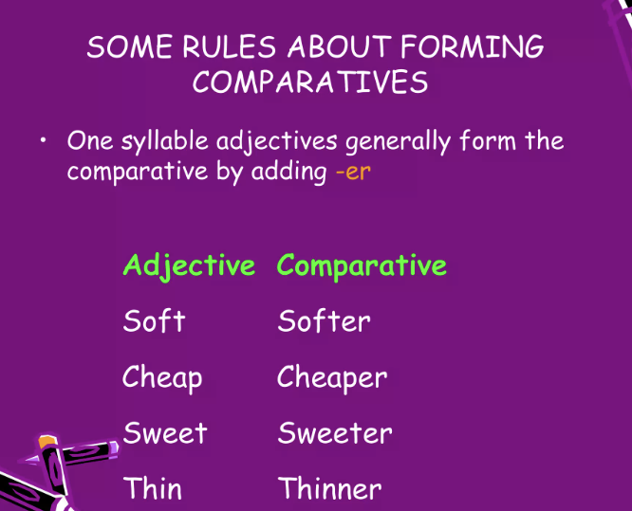

Slide 12
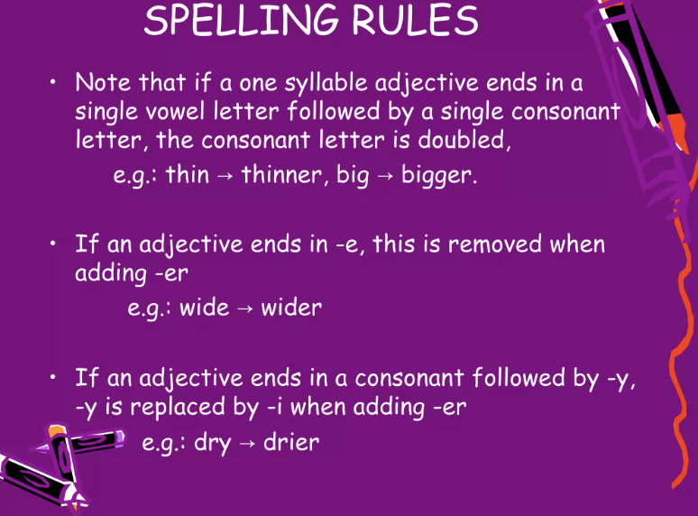

Slide 13
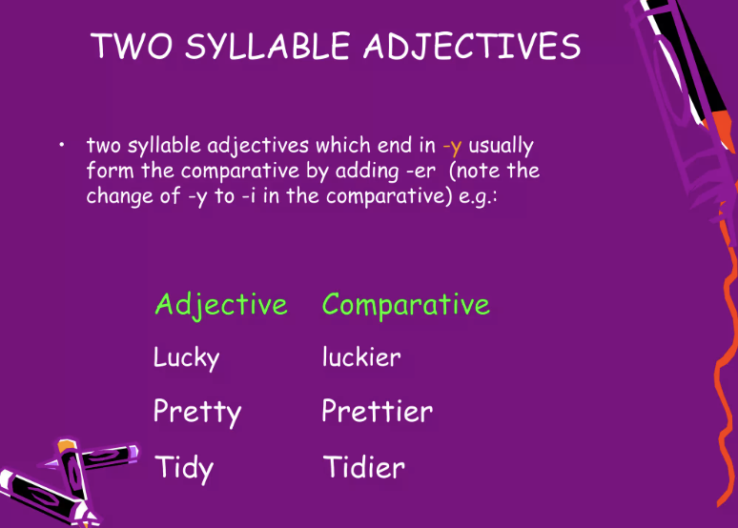

Slide 14
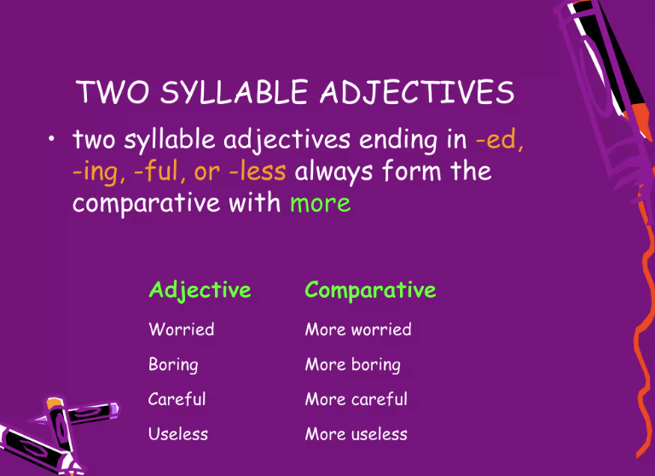

Slide 15
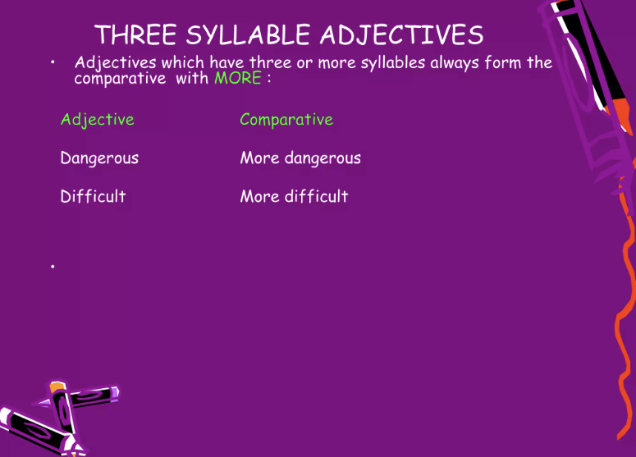

Slide 16
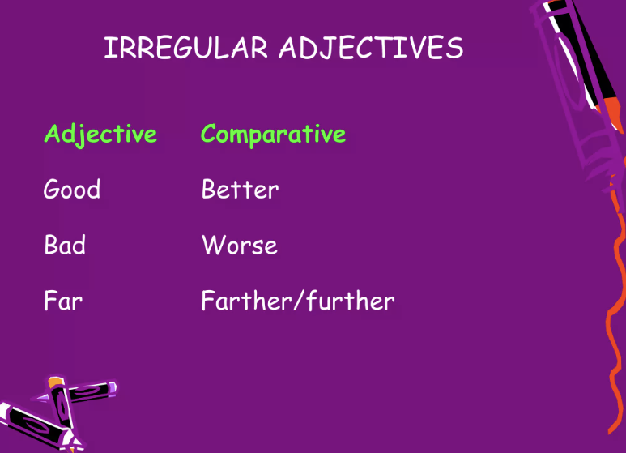

Slide 17
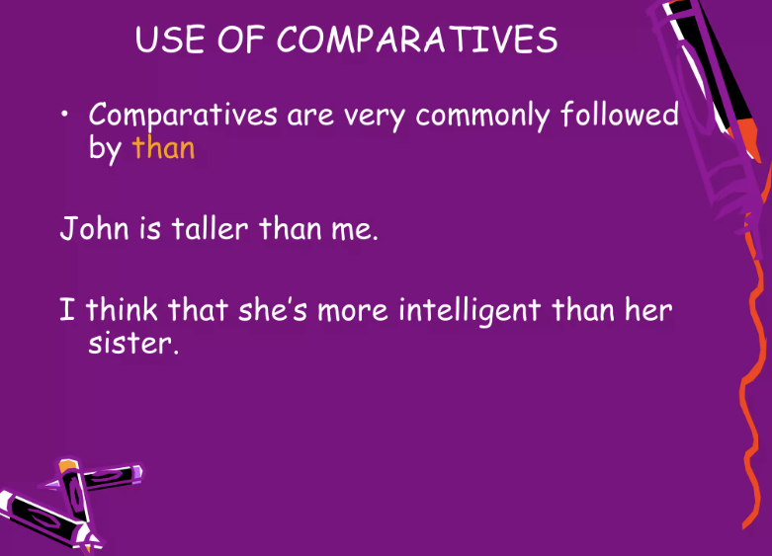

Slide 18
Practice Exercise: Fill in the correct form of the words in brackets (comparative or superlative).
My house is (big) than yours. ____________
This flower is (beautiful) than that one. ________
This is the (interesting) book I have ever read. ____________
Non-smokers usually live (long) than smokers. ______
Which is the (dangerous) animal in the world?_________
A holiday by the sea is (good) than a holiday in the mountains. ______________
It is strange but often a coke is (expensive) than a beer._________
Who is the (rich) woman on earth? ___________
The weather this summer is even (bad) than last summer. ___________
He was the (clever) thief of all. ________________

